Slide 1
Predicting Flights Arrival Delays
Doğancan Gemici
Mayasa Dablan
Samer Kanakri

Slide 2

Outline
Introduction
Dataset

Slide 3
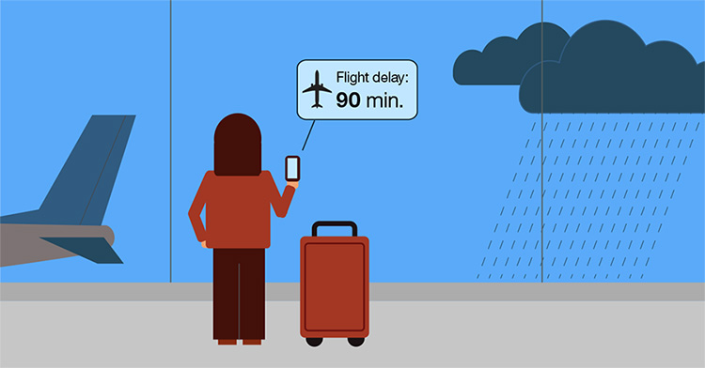
Introduction
Flight Delays causes.
Flight Delays impacts.
Who is affected?
Flights Delayed each year.
Delays costs!

Slide 4

Problem with accurate prediction models.
Ours Models? Prediction Methods?

Slide 5

Dataset
What is it?
How much Big is it?
What does it contain?
Features?
Was it clean enough?
Missed features? Missed values?
Training? Testing?
Best Features? Correlation!!

Slide 6
Feature Engineering
Predictions of Arrival Delay thanks to Average Speed
First, setting time zones to one common time zone(Istanbul’s one) which is GMT+03:00.
Then, Clustering flights based on their origin-destination pair.
For example Ist-Dub would be one cluster, Dub-Ist would be another cluster. And we were supposed to calculate average speed for each cluster.
So, whenever we get the data with distance we would be able to do division and get time which spent on the air.

Slide 7
Feature Engineering
Then we would compare with Scheduled departure time and arrival time because difference between these 2 give us «scheduled time to spend on the air» which should be equal to distance/average speed.
So when we go into details more we subtract these 2 values which supposed to be equal! So if there is any difference it is supposed to be total delay!
When we subtract departure delay from total delay. We would have our new feature which is supposed to be so close to arrival delay!!!

Slide 8
Here is little bit math (For each specific cluster):
CRS_ARR_H - CRS_DEP_H = Scheduled time that spent on the air. = X
DISTANCE / X = Average Speed for specific flights = Y
When we get new data..
CRS_ARR_H - CRS_DEP_H = Scheduled time that spent on the air = X_1
DISTANCE / Y = Gives us predicted time for flight on the air... = X_2
X_2 – X_1 = Total delay
Total Delay – Departure Delay = New Feature to use prediction for Arrival Delay!!!

Slide 9
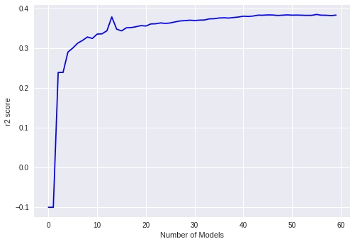
Methodology
Weak and Strong learners.
Which learner represents the
data best?
When to stop?

Slide 10
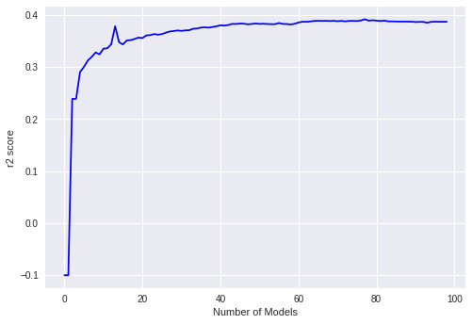
Methodology
Decision Trees
Adaptive Boosting

Slide 11
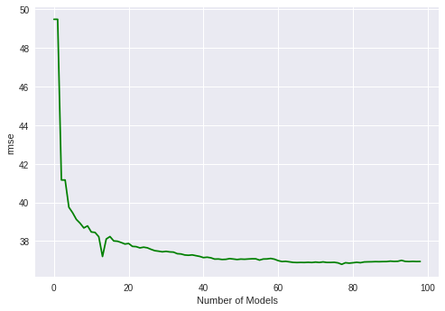
Methodology

Slide 12
THANK YOU

